Slide 1

How to improve the quantity and quality of participants for future hackathons?
G2T2
Yeo Yao Cong
Darien Tan
Kershawn Liau
Andy Pee
Ong Zhi Yi
Notes:
Good Evening Class and Professor Gao, We are G2T2, and we are helping Dell Technologies to improve the quantity and quality of participants for future hackathons hosted by Dell technologies

Slide 2
Table of contents
01
02
03
Recap
Dell Technologies
Business Problems
Sentiment Analysis
04
05
06
Topic Modelling
Network Analysis
Demonstration
07
Recommendation
Notes:
These are the table of contents we would be going through.
Firstly, we will have a brief description of dell, followed by the 3 categories we have split into : Intrinsic Motivation, trending topics and extending engagement.
Next, the architecture diagram, project management, our timeline we have planned out and lastly the conclusion.

Slide 3


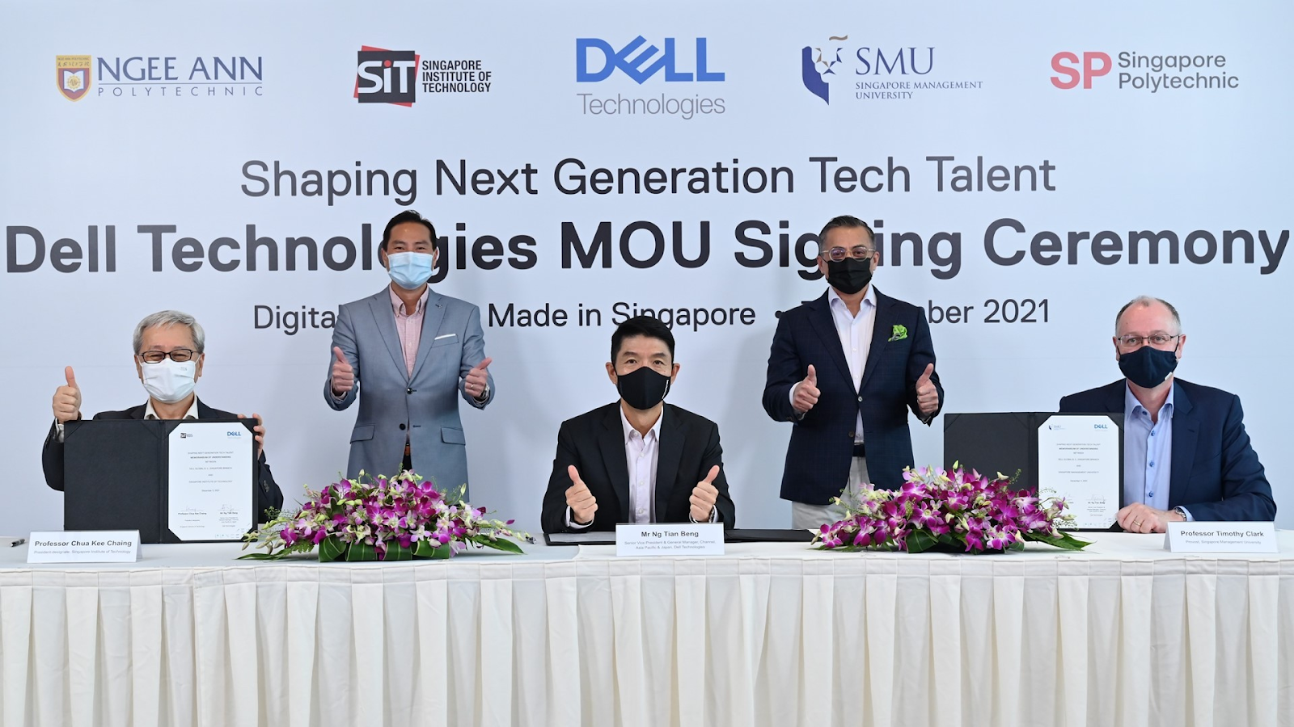



Driven by ambition and power of technology to drive human progress
Multiple Institutes of Higher Learnings Engagement to nurture the next generation of talent
Increase in partnerships with various organisations
Hackathons
Projects

Slide 4
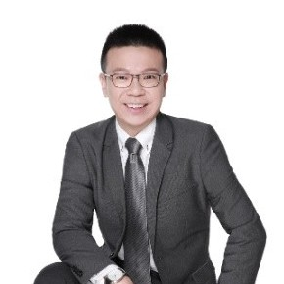
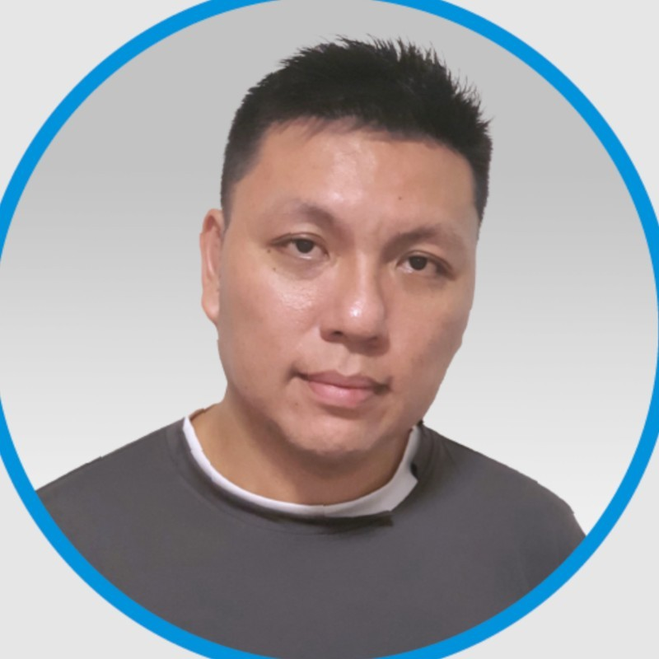
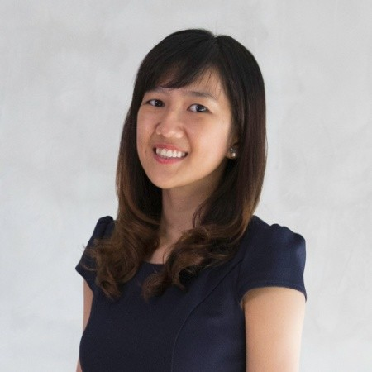


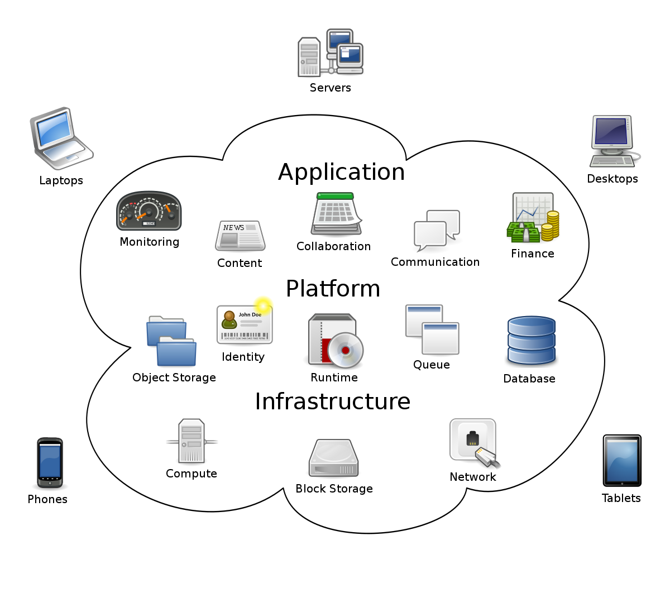

Cloud Native Architecture Team
Projects focus on Cloud Technologies
Latest hackathon collaboration
Jacky Lee
Director, Cloud Native Architecture
Eugene Swee
Principal Cloud Native Architect
Carine Chua
Senior Cloud Native Strategist

Slide 5



SCDF Lifesavers Innovation Challenge 2022
Problems faced:
Ideas across participants were similar
Low Sign-up rates
Uncertain about the hackathon scope / deliverables
Only 33.3% of teams who got selected for phase 2 (Creation of PoC) participated actively
Notes:
Low Sign-up rates
Ideas across participants were similar
Last minute blasting message on social media platforms such as Mothership
Only 33.3% of teams who got selected for phase 2 (Creation of PoC) participated actively
Is the subject scope too vague for hackathons?

Slide 6

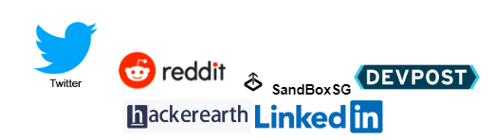
How can we better plan for Dell Technologies’ future hackathons?
Increase number of participants (and quality of participants for future hackathon engagements
Sign Up Rates
Strategise Social Media Messages
Increase Motivation for Participants
Common Trends of Hackathons
(Topics / Themes)

Slide 7
SENTIMENT ANALYSIS

Slide 8
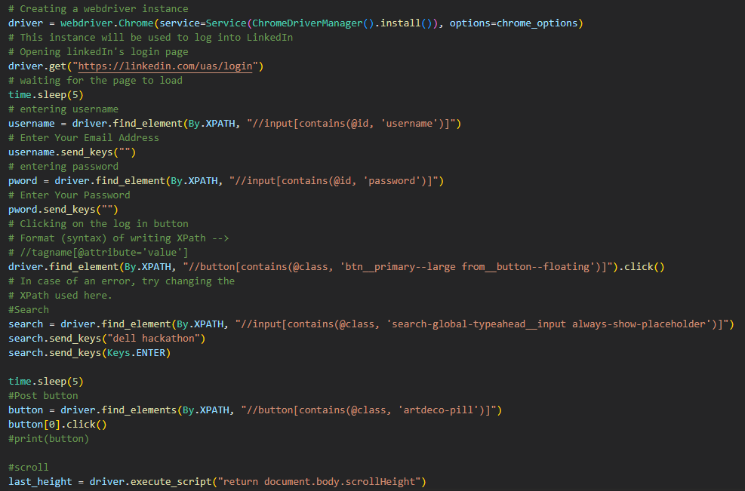

Sentiment Analysis - Data Collection
Extending Engagement with Participants
Key Tools Used for Web Scraping:
Selenium
Search post: keyword : “dell hackathon”
Notes:
Before we go through on our results of sentiment analysis, I will first be going through our data collection and analysis process. LinkedIn is one of the social media that we scraped our data from to gain insights about Dell hackathon. We used selenium to scrape LinkedIn and retrieve search results of keyword: ‘Dell Hackathon’ to see what people are saying about Dell hackathon and whether it is positive or negative.

Slide 9
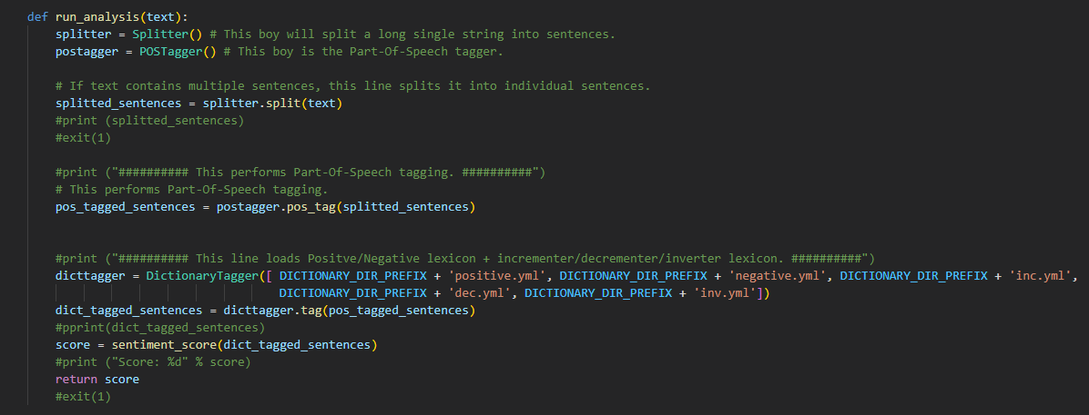
Sentiment Analysis - Tools Used and process
Extending Engagement with Participants
NLTK Package: - tokenize
- pos_tag
- lexicons
Notes:
We used the NLTK package in our sentiment analysis.
For the process of our sentiment analysis,
We first split paragraphs of text into a lists of lists of words
Secondly,Part-Of-Speech tagging is performed on each words (Noun, Adjective etc)
Lastly, we Calculate sentiment score of the paragraph/post based on the lexicons
In our analysis, we will be using positive word lexicon, negative word lexicon, incrementer lexicon, decrementer lexicon and inverter lexicon
For example; positive word +1, negative -1, incrementer *2, decrementer /2 and inverter *-1

Slide 10
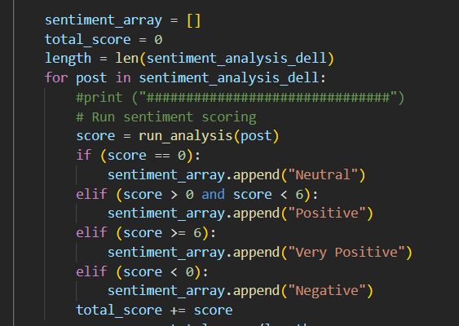
Sentiment Analysis - Tools Used and process
Extending Engagement with Participants
Negative <0
Neutral 0
Positive 0-5
Very Positive >6
Notes:
So we define Negative as below 0
Neutral as 0
Positive score as 0 to 5 and
Very positive as 6 and higher

Slide 11
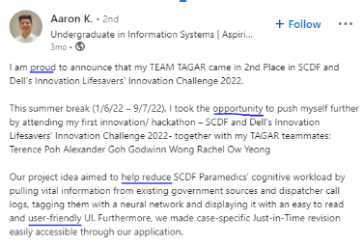
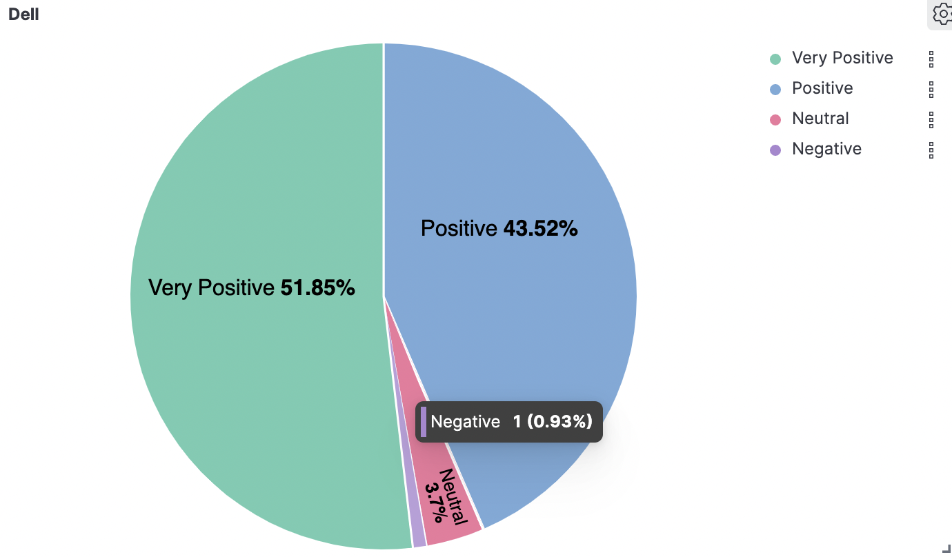
Sentiment Analysis
Motivation of Participants
- Largely Positive ( > 90% )
- Number of Posts are not a lot due to low number of participants
- Nature of LinkedIn to be formal and used for connections in professional world
- Post are filled with mostly positive keywords rather than negative
Keyword: ‘Dell Hackathon’
Notes:
This are the result from the data that we scraped. By using the keyword ‘Dell Hackathon’, we get a sentiment that is mostly positive. However this result are not very representative of the overall sentiment of Dell as the number of post related to Dell Hackathon are very little. The nature of LinkedIn is also more formal and used for connections in the professional world. Users that make a post will thus usually use positive keywords rather than negative.

Slide 12
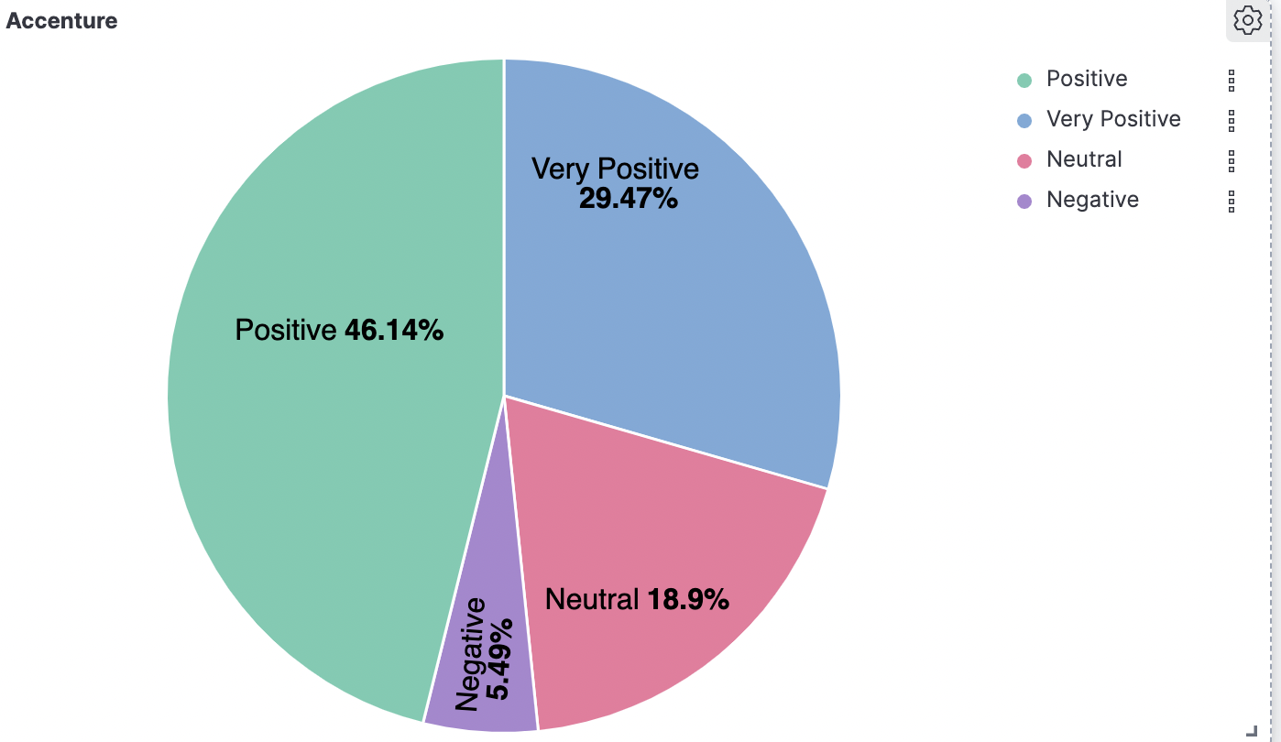
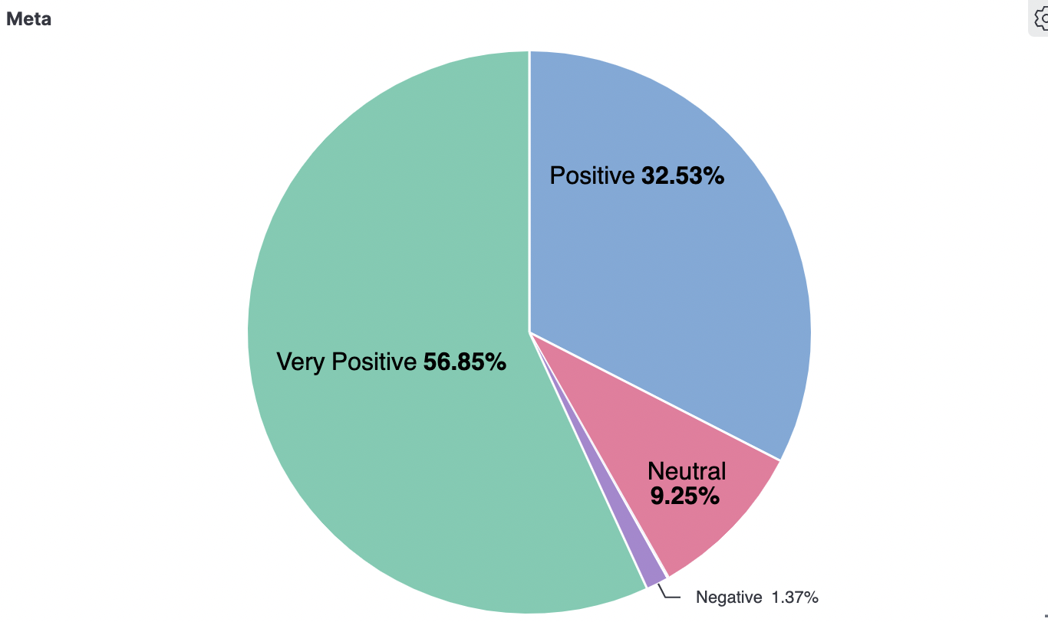
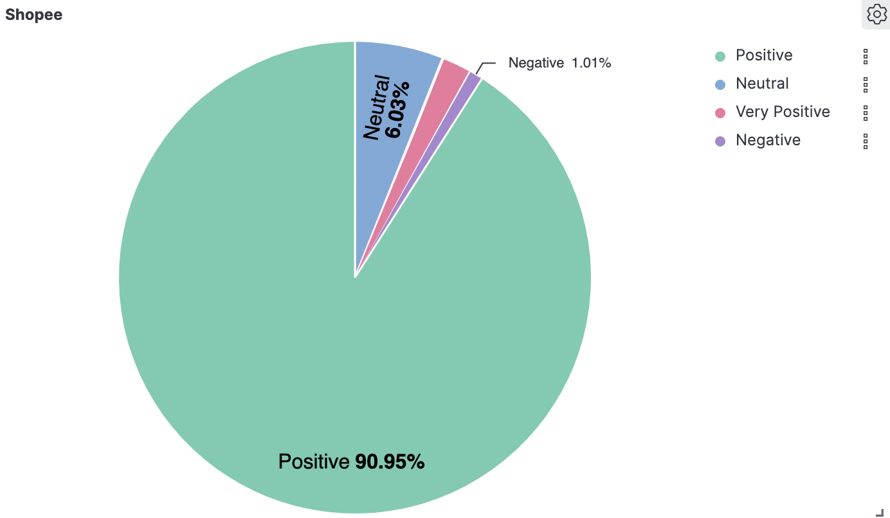
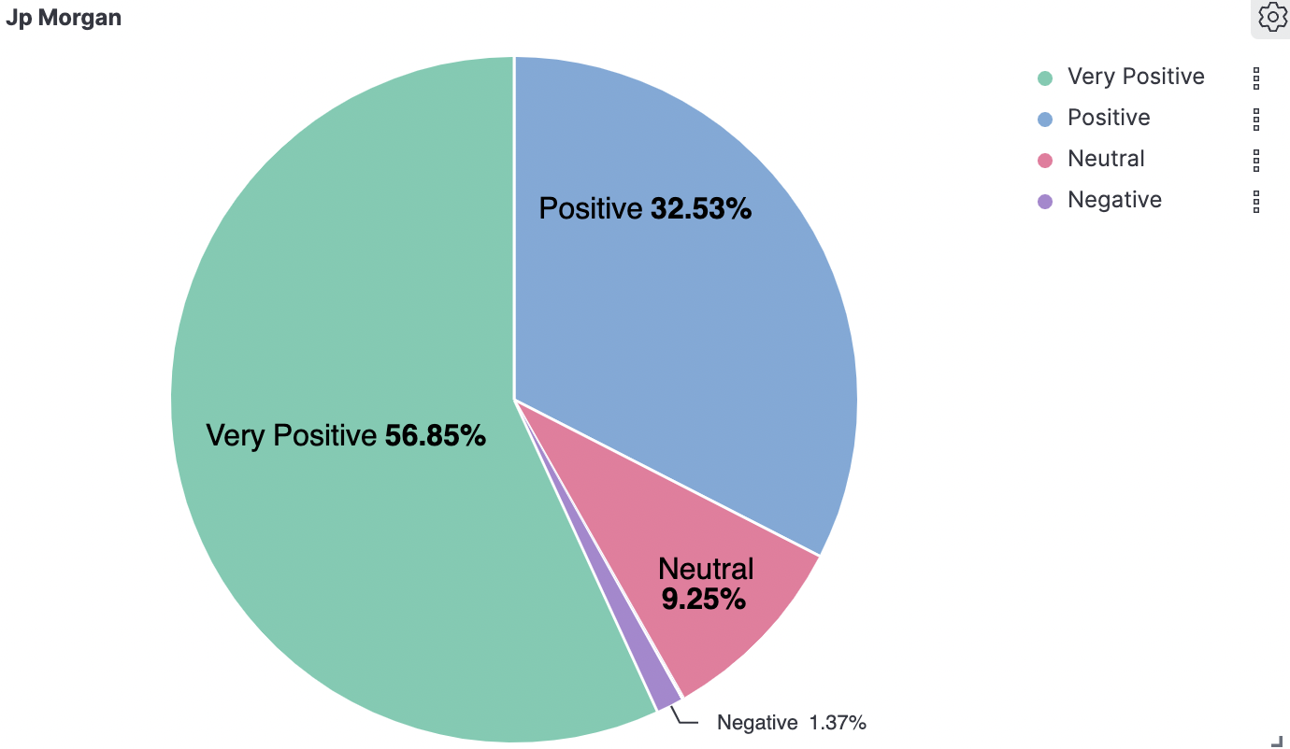
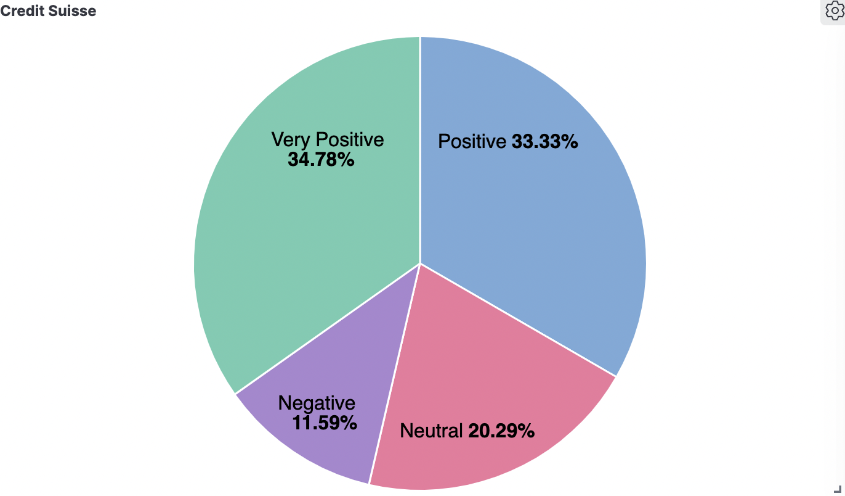
With overwhelming positive responses..
Mostly Positive!
Post proved to be mostly positive
Not a good source of information for our analysis
Data are skewed towards positive
Notes:
We also scraped other hackathons to get their general sentiments and also found it to be mostly positive. This makes LinkedIn not a very good source of information as the sentiments tends to be skewed towards positive. We thus scraped other social media as well to gain insights on Dell Hackathon.

Slide 13
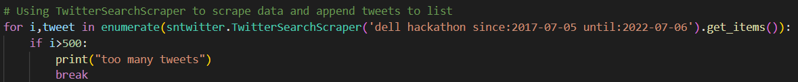

Sentiment Analysis - Data Collection
Extending Engagement with Participants
Key Tools Used for Web Scraping:
SNScrape
Search post: keyword : “dell hackathon”
Notes:
Twitter is another social media platform that we scrape to gain data about Dell Hackathon. We used tools such as SNScrape to web scrape twitter.

Slide 14
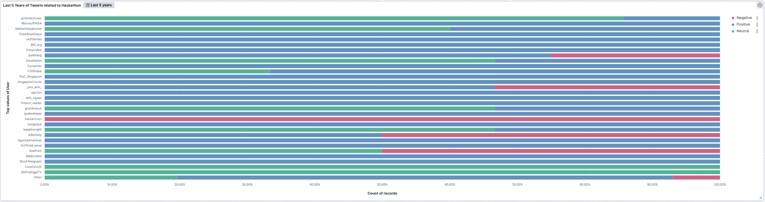
Sentiment Analysis
Extending Engagement with Participants
Competitor’s Sentiment Analysis
Tech-industry competitors who hosts hackathons
Proportion of negative reviews are more well distributed
Twitter does not have the nature of posting positive tweets, unfiltered, raw content
Notes:
We tried to scrape ‘Dell Hackathon’ in twitter and found out that there are not much post related to Dell Hackathon in the recent years.
Similarly, we also scraped sentiment of other tech-industry competitors who hosts hackathons and found out that the proportion of negative reviews are more well distributed now.
This could be due to the nature of Twitter which are more unfiltered and people have the freedom of speech here. This makes Twitter a much better source of information.

Slide 15
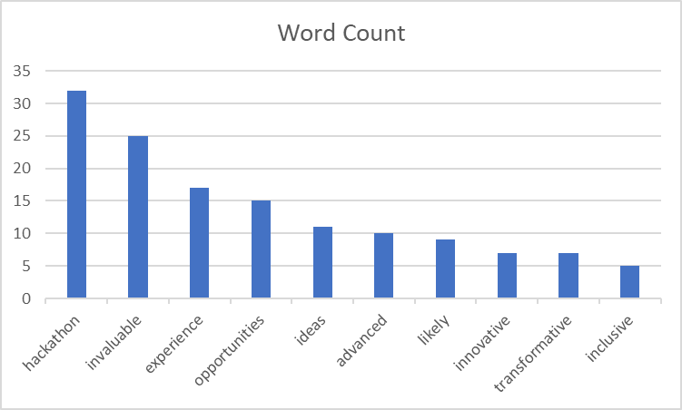

Sentiment Analysis
Extending Engagement with Participants
Microsoft Asia Hackathon - 100% Positive Sentiments
Data gathered can aid Dell Technologies in strategising Social Media Announcements for new hackathon events
Key Word: ‘Microsoft Asia Hackathon’
Bring Dell Technologies closer to participants/consumers
Notes:
We will be taking a look at Microsoft Asia hackathon, who received a 100% positive sentiment according to our previous slides. We also scraped post of how Microsoft Asia hackathon posted their hackathon events and gathered the top ten most frequently appeared positive keywords. This data can then be used by Dell Technologies to effectively use these keywords to attract participants for their future hackathons.
Not sure about increase awareness etc etc.

Slide 16
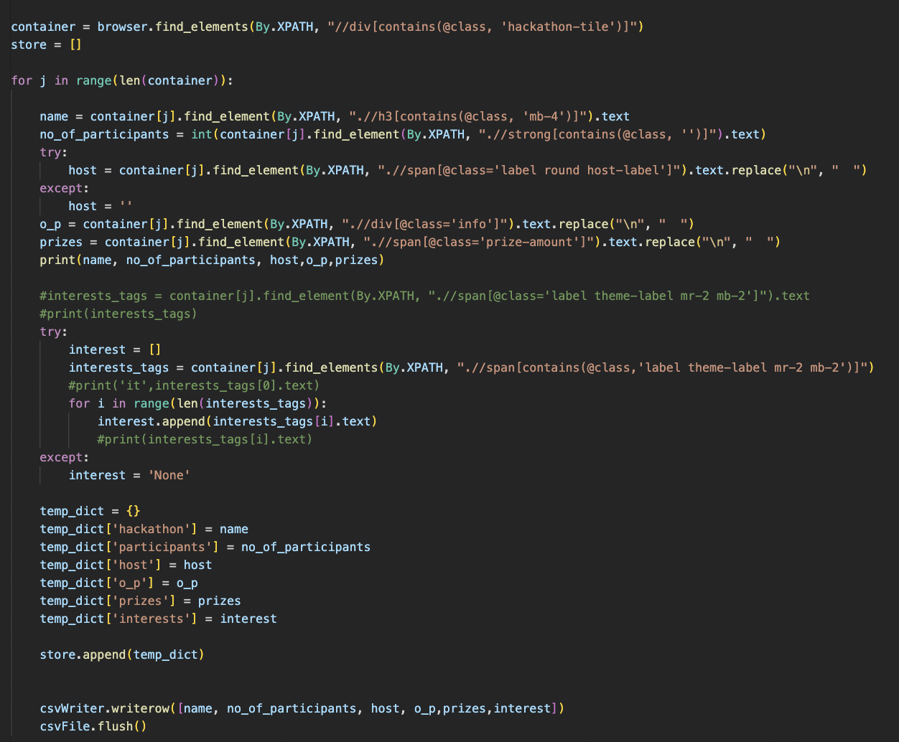

Insights and Findings - Data Collection
Key Tools Used:
Selenium
Obtaining fields:
Hackathon name
Number of participants
Value of Prizes
Interests
Notes:
To deep dive further into how Dell can extend our engagement with participants, we used selenium to scrape devpost,which is a page that list tonnes of hackathons and their details. So how we scrape DevPost is firstly looping through each container and under each container search for hackathon name, number of participants, values of prizes and interests of that particular hackathon.

Slide 17
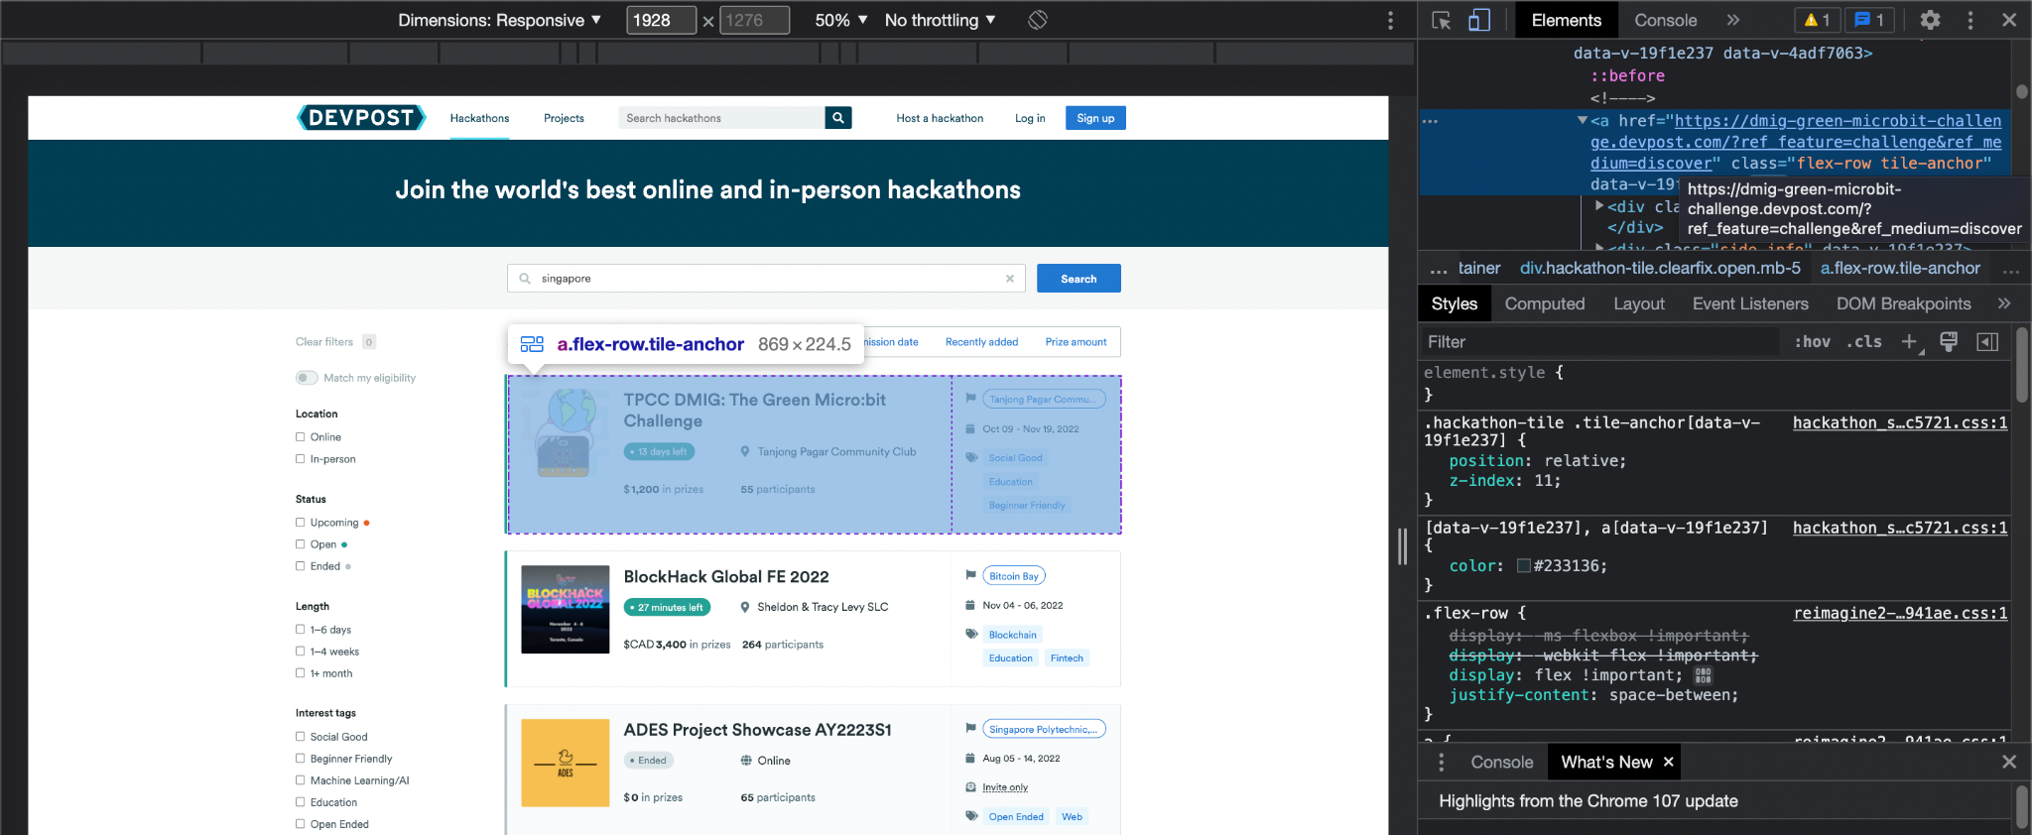
Insights and Findings - Data Collection
Notes:
Example of how it looks like

Slide 18
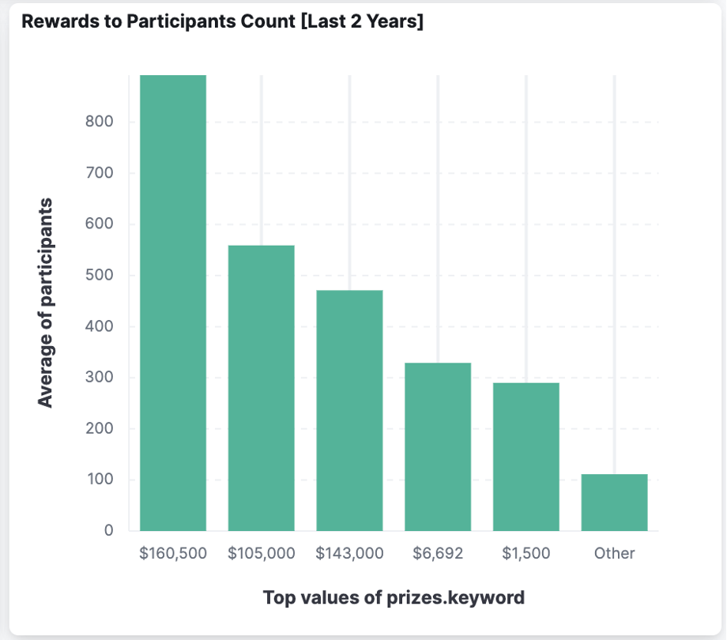
Insight from DEVPOST
A Specialised Global Hackathon Repository
The larger the prize pool (monetary value) the higher the number of participants in that hackathon
If we calculate intangible material benefits such as internship opportunities, we observe that hackathons that are likely to be tied to employments or internship opportunities are likely to have a huge number of participants.
Notes:
From the scraping, we also identified that larger prize pool leads to higher number of participants in that hackathon.
We also realised that hackathons with internship opportunities or employments, tend to have huge participants as well.

Slide 19
TOPIC MODELLING

Slide 20

Trending Topics - Tools Used
Extending Engagement with Participants
Tools
Visualisation
Datasets
SNScrape
Tweepy
praw
Selenium
Pandas
vaderSentiment
Gensim
pickle
pprint
pyLDAvis
Descriptions from SandBoxSG
Posts: Keyword “Singapore Hackathon”
Subreddit:
r/hackathon
r/nus
r/SGExams
Notes:
Now we’ll talk about the trending topics and the tools that we use. We used SNScrape and tweepy for twitter, selenium for linkedin, reddit and sandboxSG. pandas for creating dataframes, vadersentiment, gensim, and pickle for the analysis. For visualisation, we used pprint and pyLDAvis. The data sets that we scraped are descriptions from sandboxsg, posts with keyword singapore hackathon from twitter and linkedin, and lastly the subreddit hackathon, nus and sgexams

Slide 21
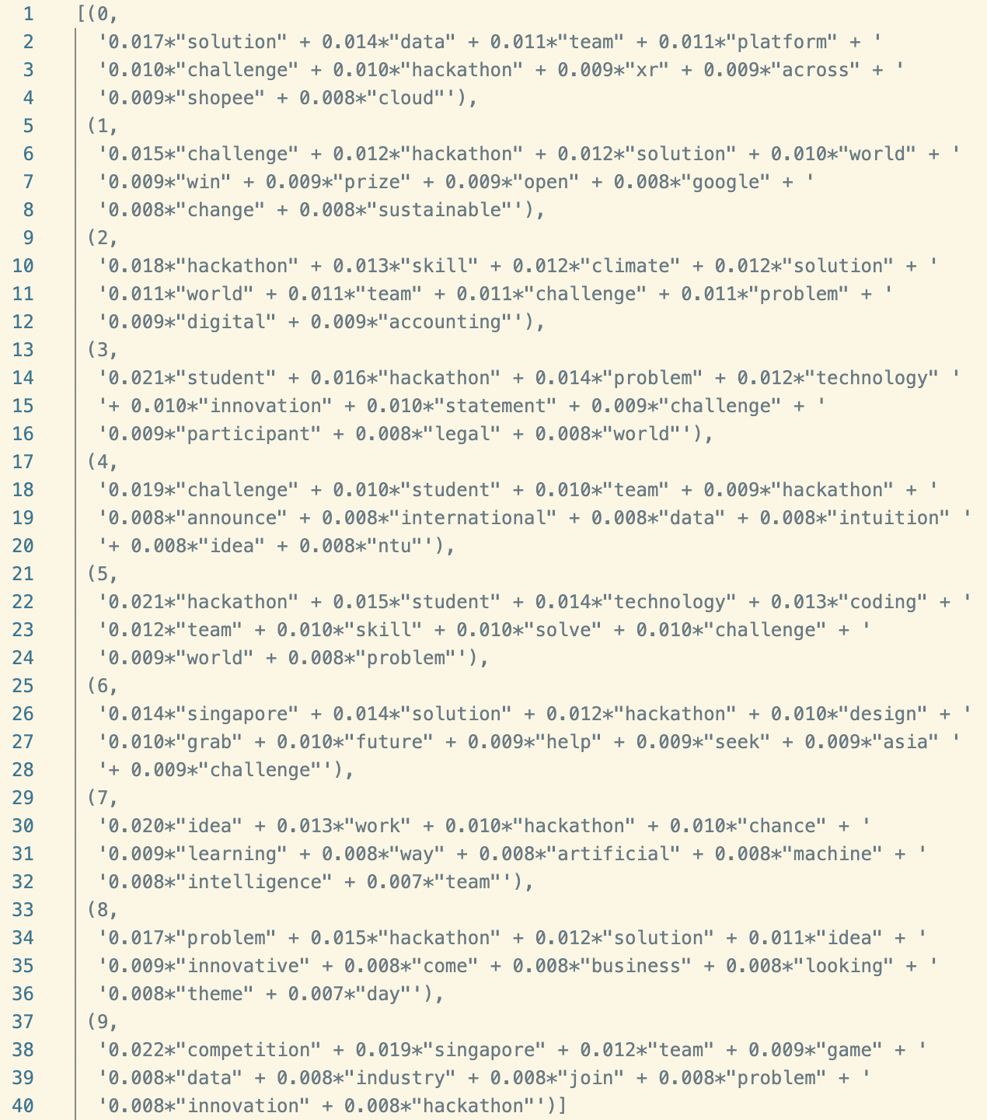
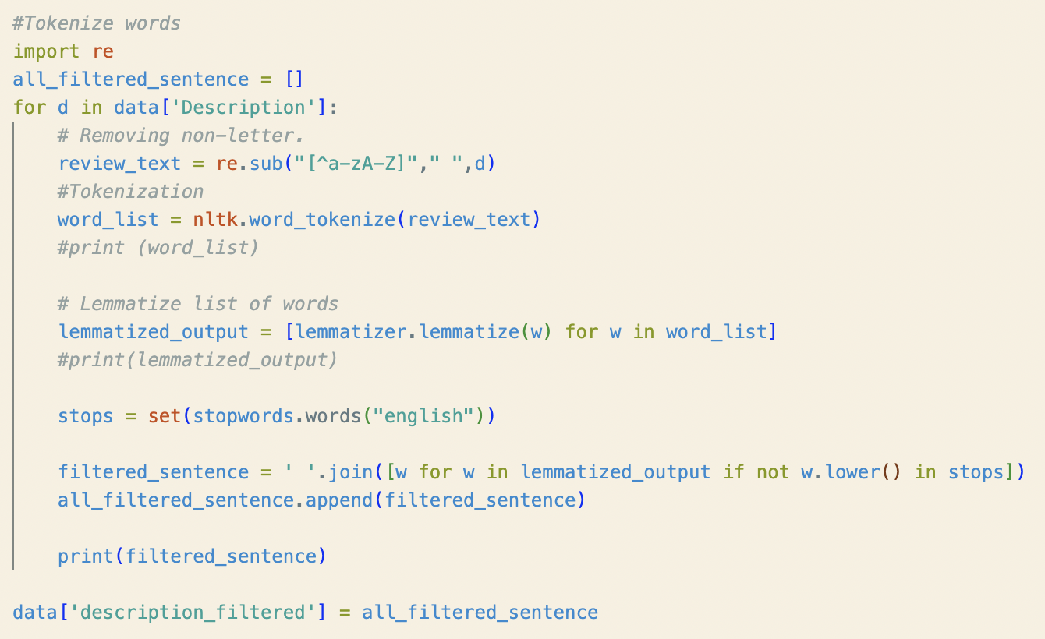
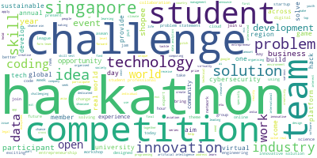
Topic Modelling - How?
Extending Engagement with Participants
Latent Dirichlet Allocation (LDA)
Load data
Clean data
Exploratory analysis
Prepare data for LDA
LDA model training
Analysing LDA model results
Model Parameters
Number of topics: 10
Number of words per topic: 30
Notes:
After importing and cleaning the data, by removing http links, punctuations, and lower casing the text, removing irrelevant data from the dataset, we can do a word cloud to display our data set. With the word cloud, we can visualise that our cleaning is sufficient to proceed to the next step.
To prepare our data for LDA, we need to tokenize our data by performing stopword removal and lemmatization. To do this, we used the nltk library from python. After that, we convert the output into a corpus and dictionary. To obtain the best number of topics, we need to run the LDA multiple times, with different number of topics and alpha and beta values. We should decide on the number of topics with the highest coherence score. We went with 10 topics.
We built the model using the gensimLDAmulticore library. You can see the words for each topics and the weights that each word contributes to the topic.

Slide 22
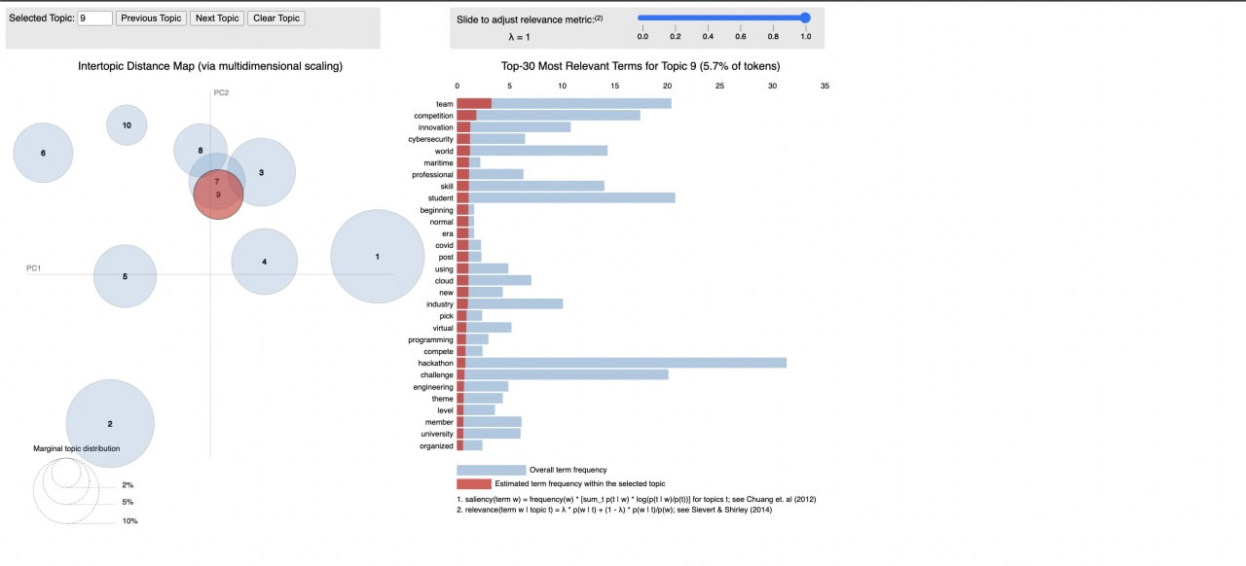
Topic Modelling - SandboxSG
SandBoxSG
Notes:
Now, we can finally start analysing our LDA model. We used a library pyLDAvis to visualise the model. We are presented with an interactive html file that allows us to explore the different topics.
Each bubble represents a topic. The larger the bubble, the higher percentage of the number of post in the corpus is about that topic.
Topics 7,8 and 9 are overlapping, this means that they have similar topics. A good topic model would have large and scattered bubbles and we would be able to distinguish between the different topics.

Slide 23

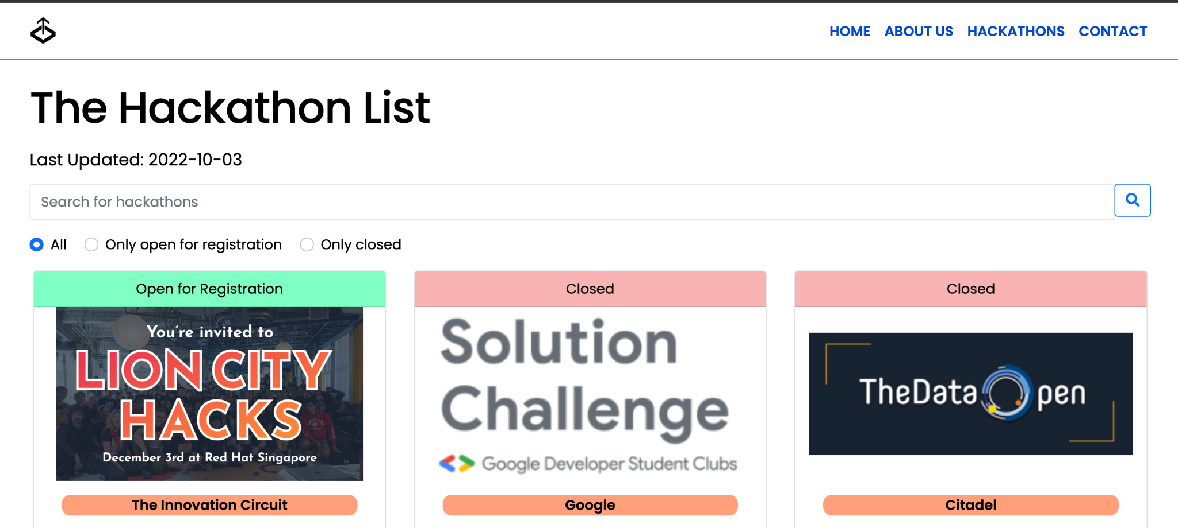
SandBoxSG
Separating based on Difficulty
Beginner-Level
A hackathon is an event designed to use technology, mostly coding, to achieve an established goal. At this type of hackathon, that goal might include experimenting with Java, Python, or one of the other best programming languages for beginners.
Advanced-Level
Intermediate-Level
Multi-phase challenge - Ideation & Implementation - Ideas will focus on real-life and actual use-cases
Developers to come up with a demonstrable MVP in a short time based on a particular theme or addressing a certain problem (smaller scale).
Notes:
For sandboxSG, they classify their hackathons into 3 different categories, beginner, intermediate and advanced. At the beginner level, the goal is usually established and participants actively code to achieve the results. For intermediate, participants have to come up with a demonstrable MVP in a short time with certain themes or problems to solve. Lastly, advanced level is a multi phased challenge, that combines both ideation and implementation. The ideas tend to focus on real life and actual use cases.

Slide 24
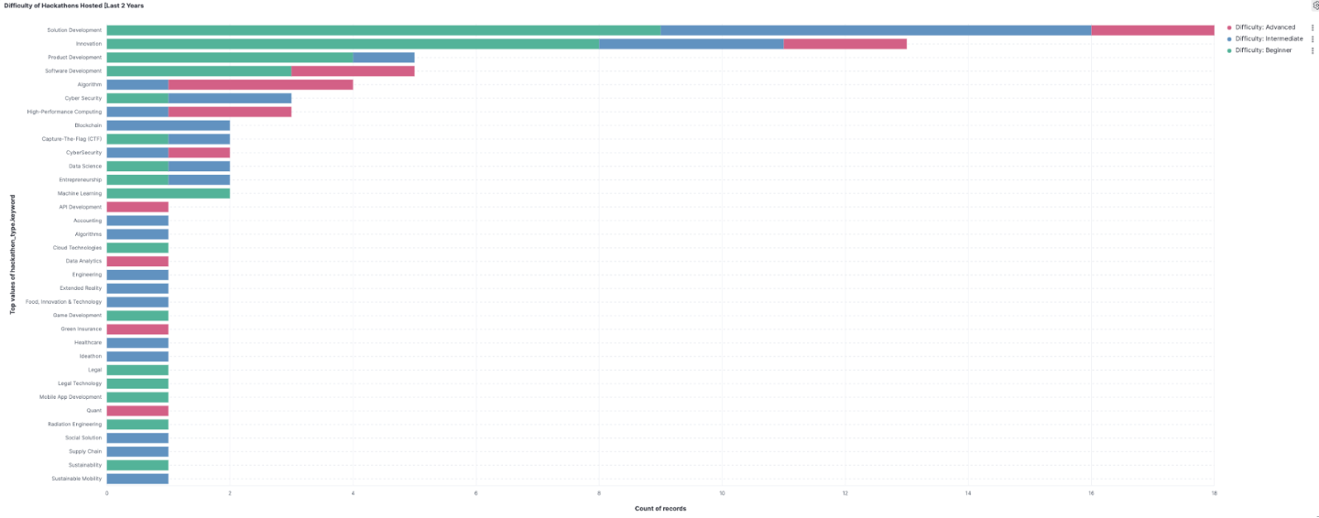
SandBoxSG
No. Registrations & Difficulty of Hackathons Last 2 Years
Easier difficulty hackathons have more registered participants
Notes:
After scraping SandboxSG, we found out that easier hackathons have more registered participants in the past 2 years.

Slide 25
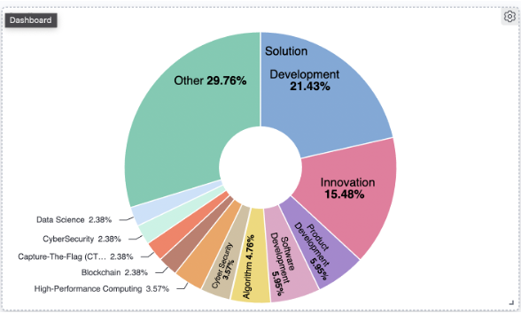
SandBoxSG
What Hackathons are hosted in the Past 24 Months
Hackathons can have multiple themes:
- limited to hackathons held in Singapore since 2020:
Innovation (Ideation, similar to SCDF Hackathon, pitching the idea, selected idea moves forward)
Trending Topics:
Soln Dev, Innovation, Product Dev, Software Dev, Algo based
Notes:
These are the hackathons held in the past 24 months, having trending topics such as solution dev, innovation, product development, software development and algorithm based. Innovation is ideation, where participants come up with a creative idea. Just like the hackathon that dell hosts, the scdf hackathon, the participants idea that are good will proceed to the next round.

Slide 26
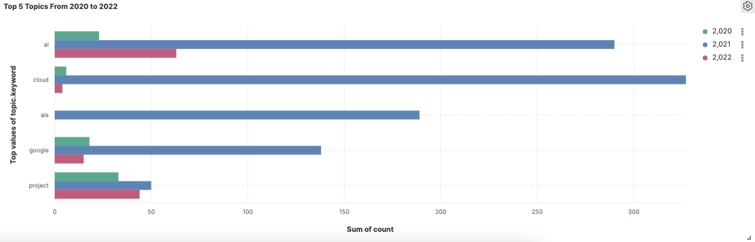
Trending Topics
But is the trend accurate?
We can deduce that these are the more common topics that developers / hackathon participants are more interested in. In 2021, Cloud and AI are leading the topic discussion. Cloud is dying down in 2022
Notes:
We scraped reddit for keywords in the subreddits and this is what we’ve got. In 2021, there were a lot of hackathons with the cloud and ai topic.

Slide 27
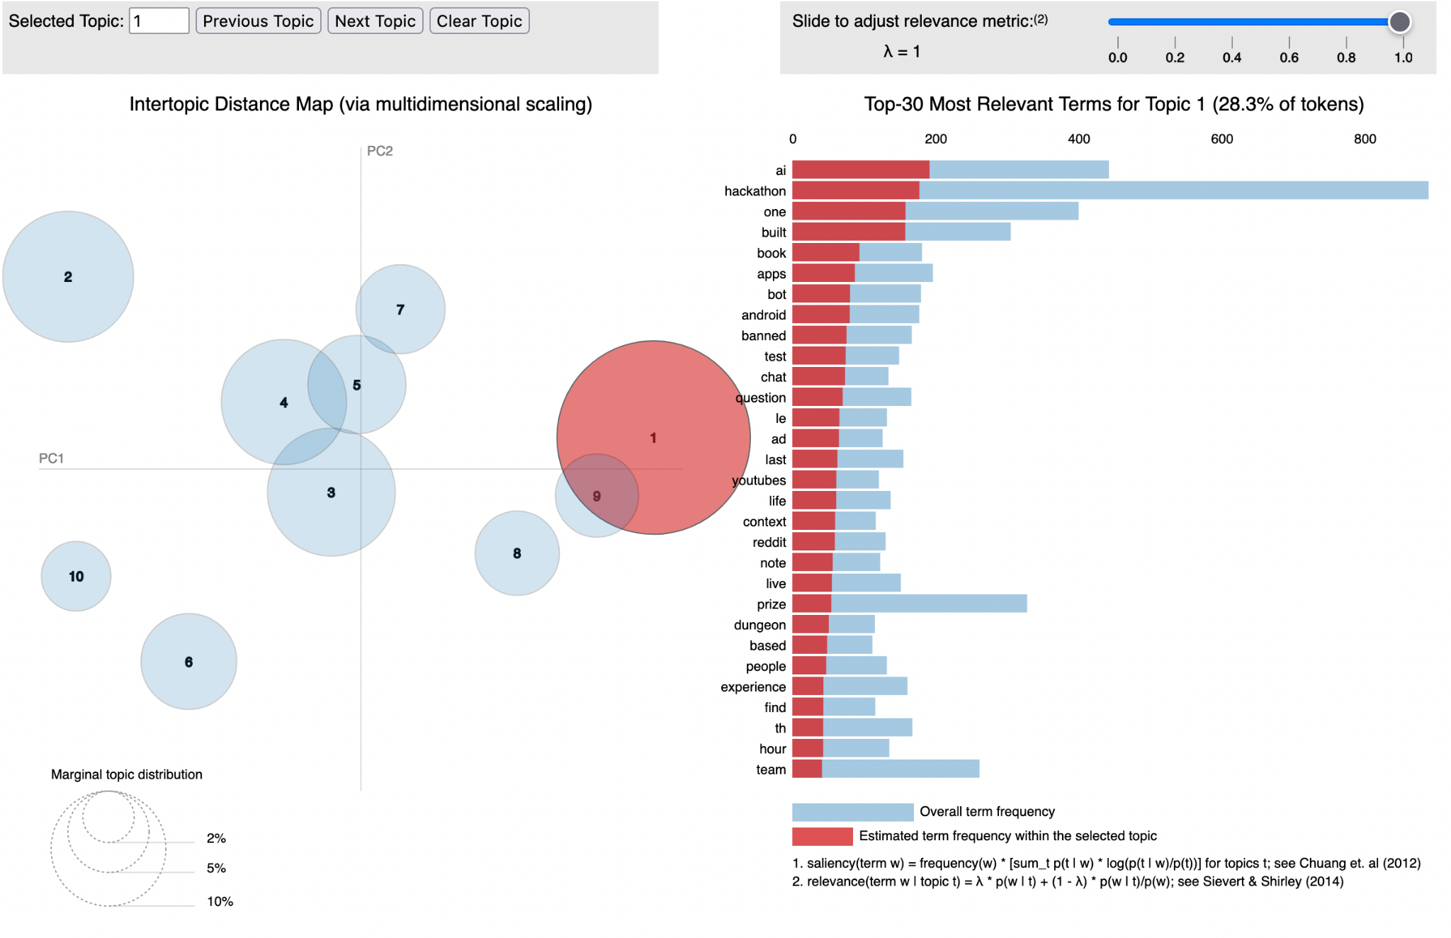
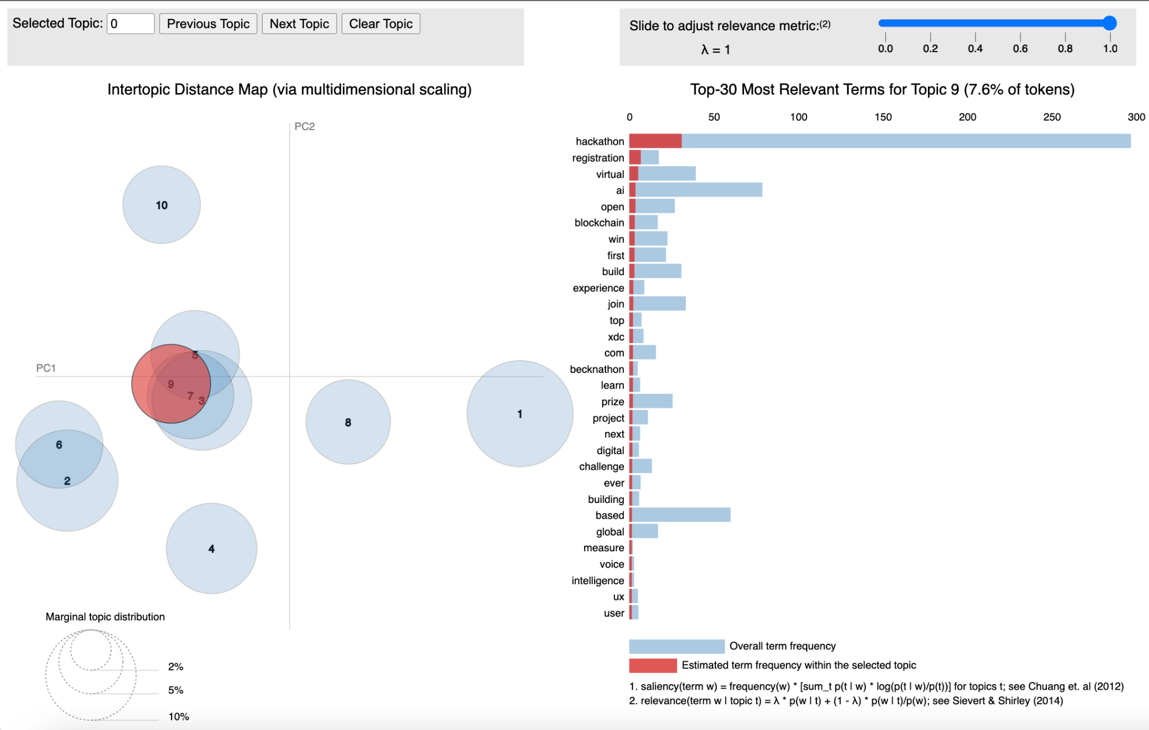
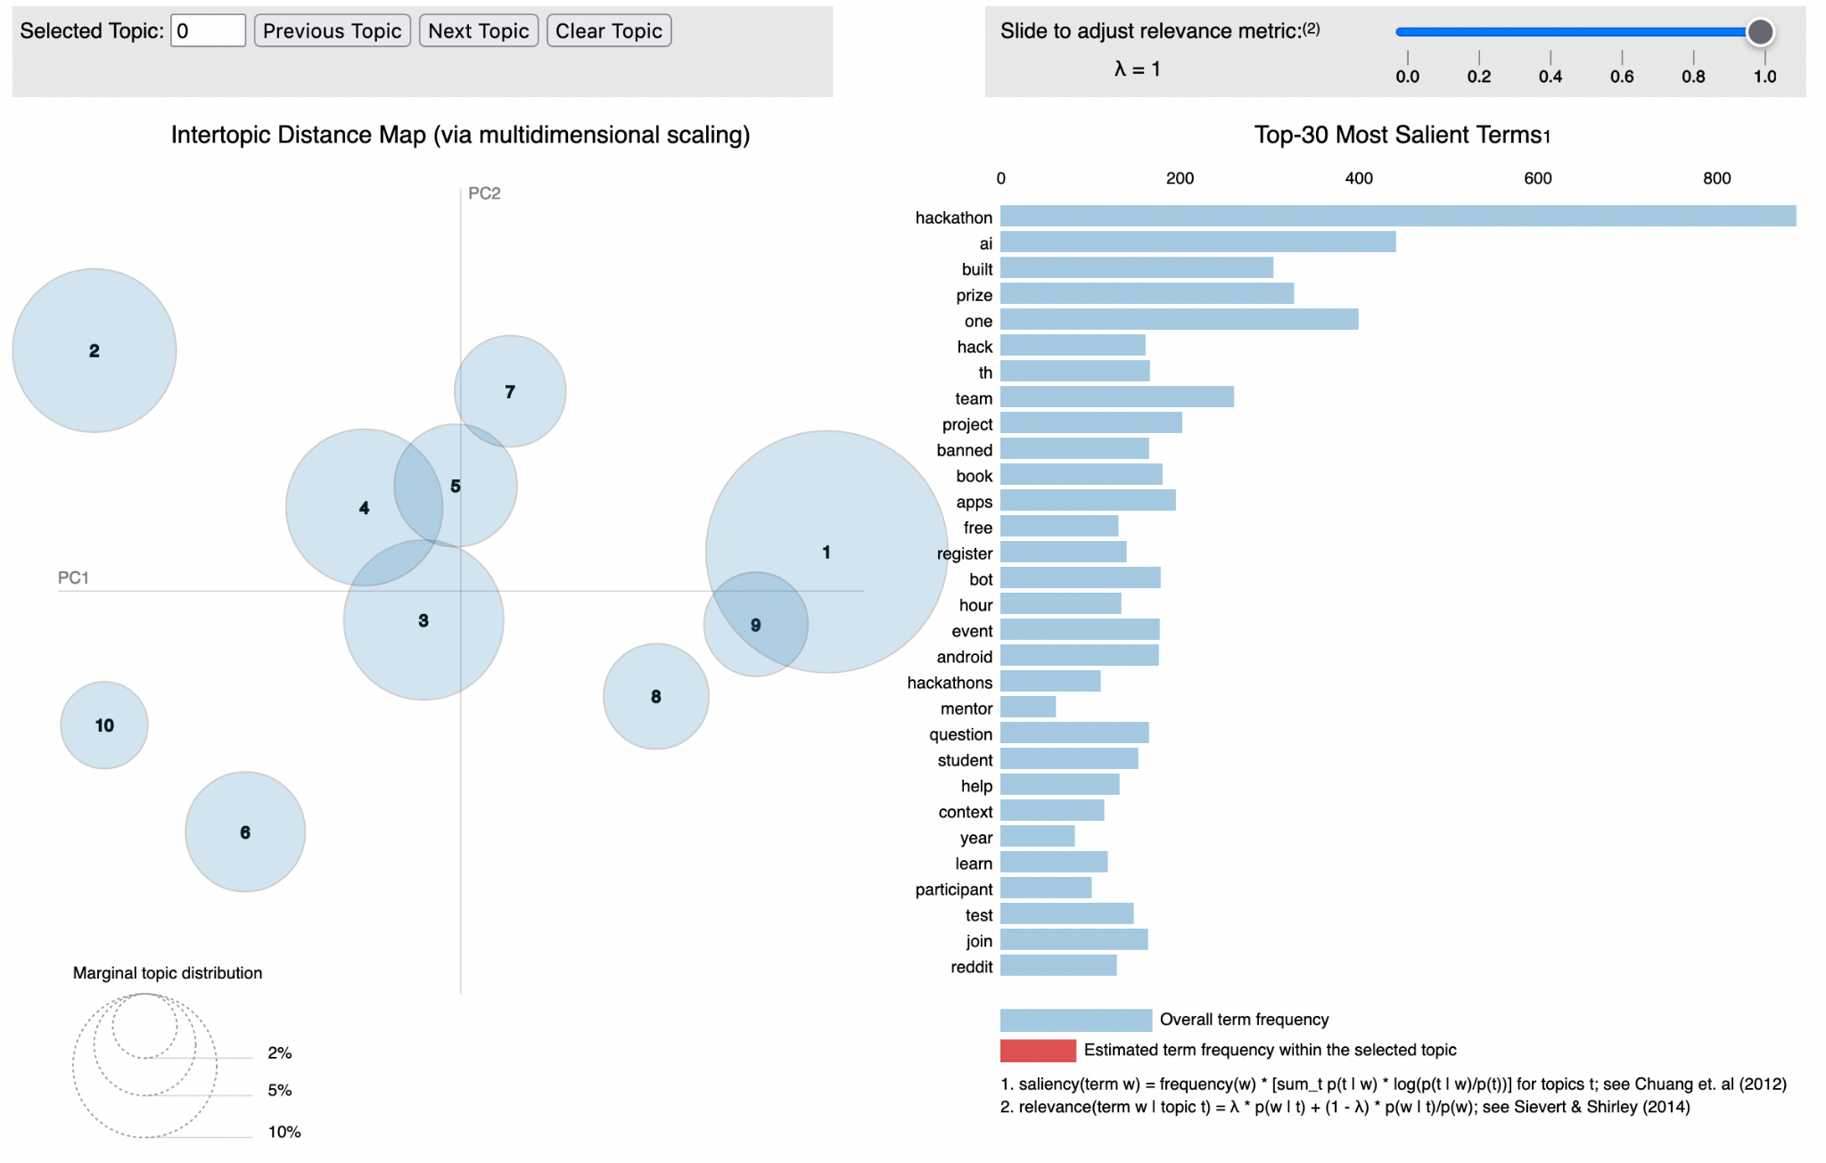
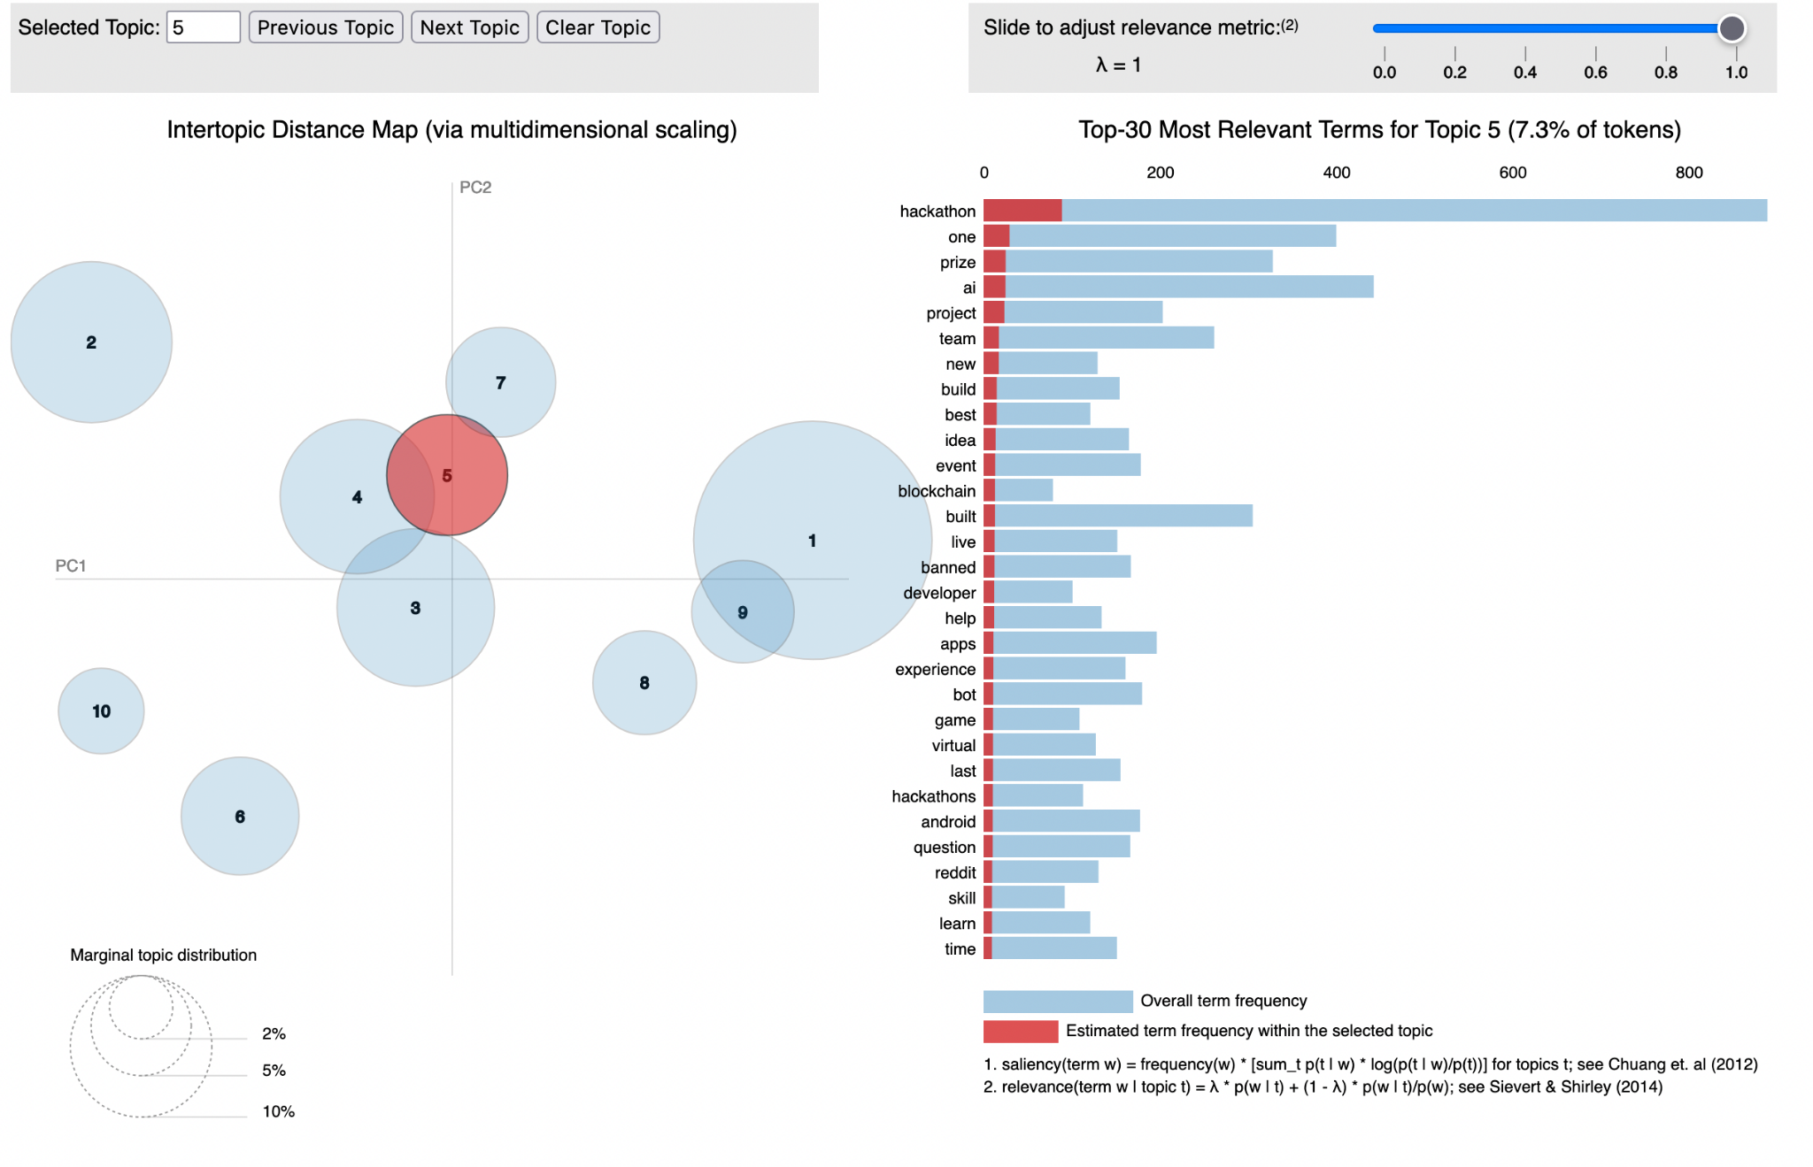
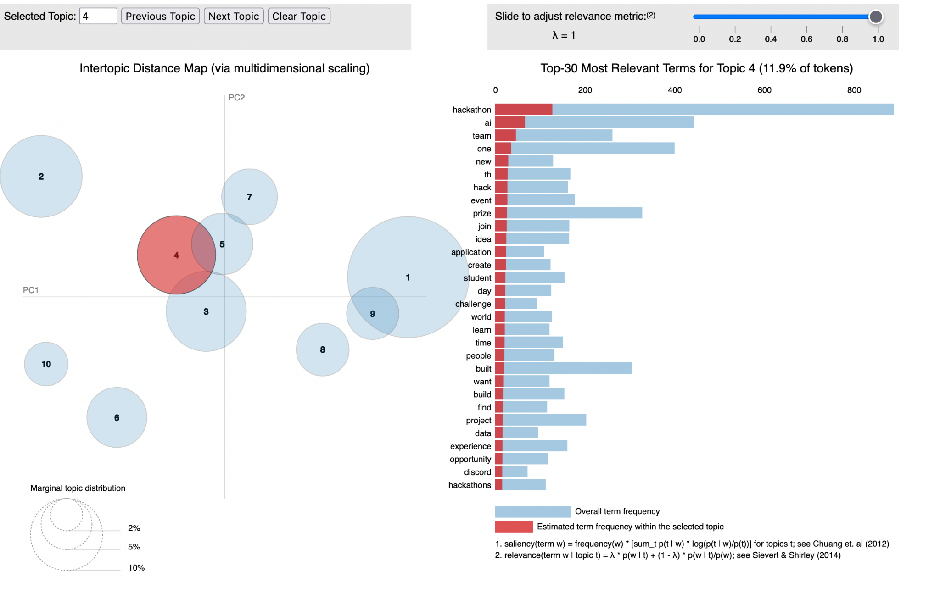
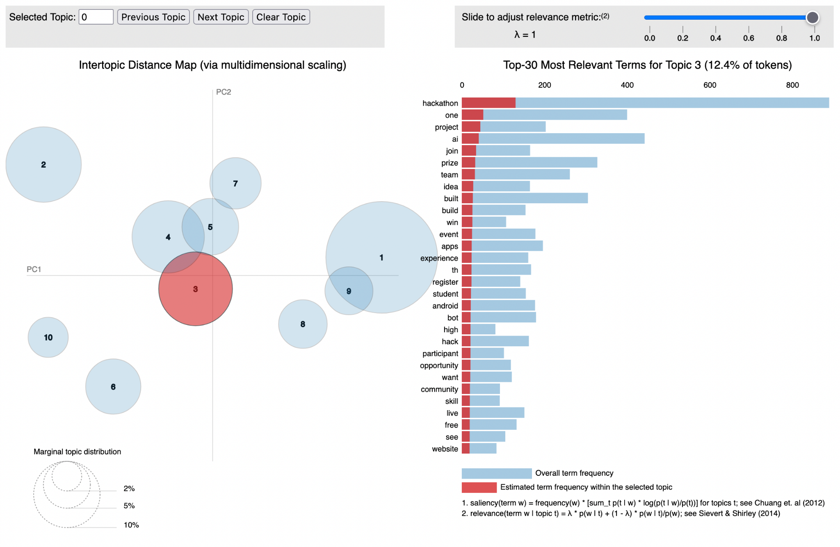
Topic Modelling - Reddit r/hackathon
Commonly typed Words:
Topic 1 - AI, build, book, apps, android
Notes:
We also did topic modelling for reddit r/hackathon. As you can see on the right, topic one is the largest and there is a large amount of posts about that topic in the corpus. If we look closer, the popular words are AI, build, book, apps, and android. We can assume that an android app with AI is the most popular kind of hackathon for 2021.

Slide 28
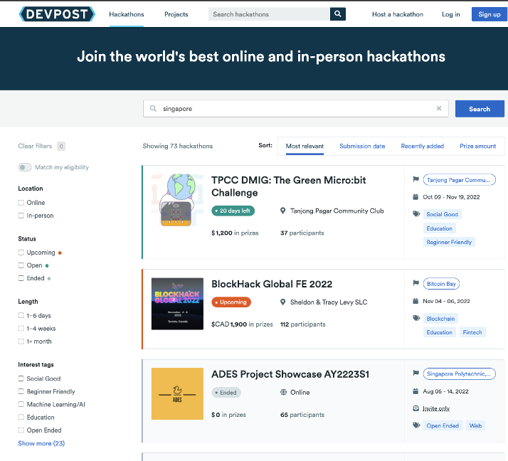
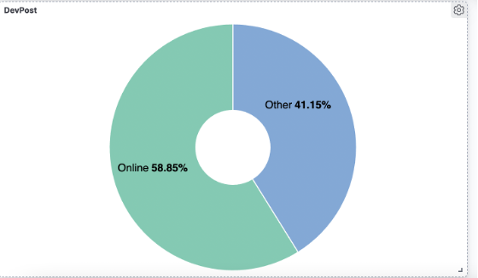
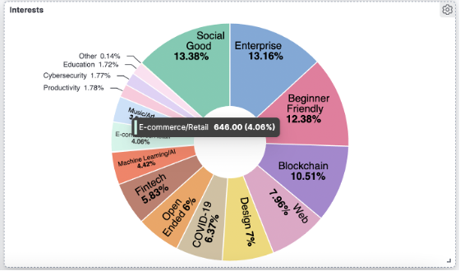
Devpost - Filtered by Singapore
What Hackathons are hosted in the Past 24 Months
Notes:
This is devpost, which is a platform for hackathon, just like sandboxSG. In the past 24 months, we can see that there are many different types of topics, the most being social good. It is good to note that beginner friendly is an important topic. Also, more than half of these hackathons are held online, which can be attributed to the pandemic.

Slide 29
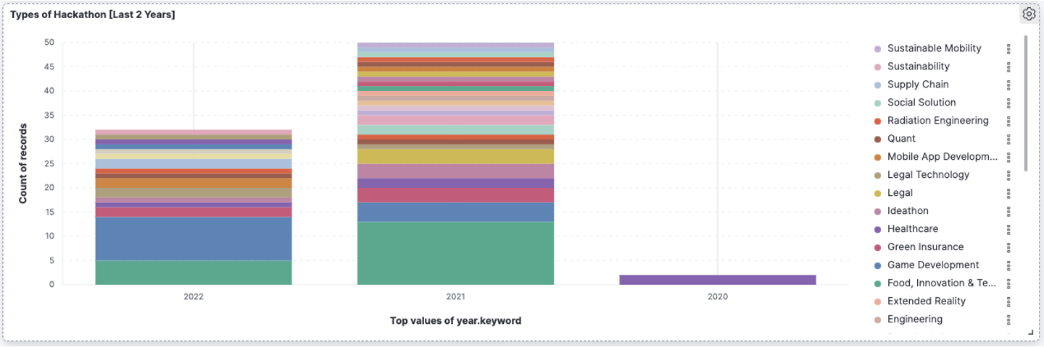
Devpost - Filtered by Singapore
1) Supply Chain Mgt is growing in trend.
2) COVID-19 is normalised and becomes part of our lives, Healthcare and Food & Technology Hackathon reduced over the year.
3) Game Development started growing due to the increased in adoption for Unreal Engine 5
Where is the Cloud? Cloud is an enabler for most of the themes in the hackathon.
Notes:
Game development and supply chain has shown a huge increase in interest towards participants
Most commonly hosted Hackathons for 2022 prioritises on Game Development
With Covid-19 becomes part of our lives, HealthCare hackathon reduced over the years
Ironically, we do not see Cloud in the field of these hackathons.
Because Cloud as a Topic is often used as an Ideathon, for participants to leverage on Cloud Technologies to build their solution

Slide 30
NETWORK ANALYSIS

Slide 31

Network Analysis - Tools Used
Tools
Visualisation
Datasets
How?
networkx
tweepy
community
- community_louvain
Matplotlib
- pyplot
Retrieve Dell’s followers’ followers
Reach - Retrieve Dell’s top 25 followers
Engagement - Retrieve retweeters of most recent 200 posts

Slide 32
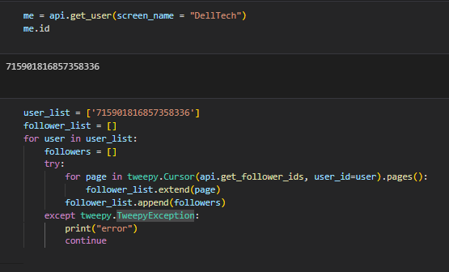
Network Analysis - Dataset
(Dell’s followers’ followers)
Get User ID of DellTech
Append User ID of DellTech’s followers

Slide 33
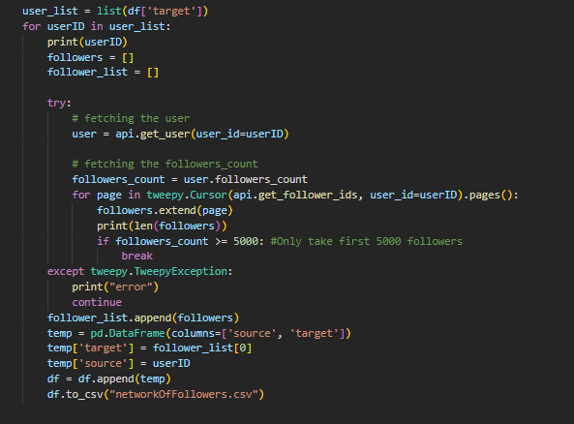
Network Analysis - Dataset
(Dell’s followers’ followers)
3. Iterate through the followers of DellTech
4. Retrieve their first 5000 followers
5. Append them to follower_list
6. Repeat for x number of iterations

Slide 34
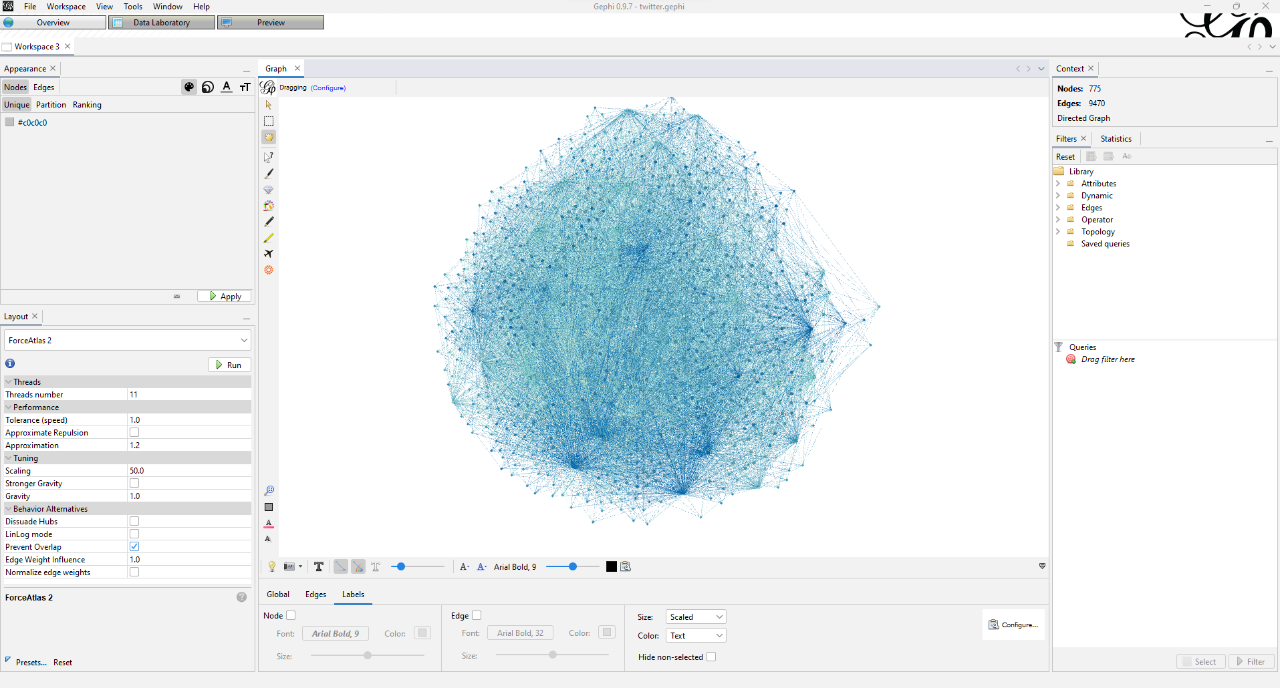
Network Analysis
(Dell’s followers’ followers)
Initial Results
We attempted to create a network graph based on what we have scraped.
However, Tweepy API’s limitation of 900 requests/15 mins does not allow us to continuously scrape for its followers.
Therefore, the network graph was limited in size and not comprehensive enough to bring us insights.

Slide 35
Network Analysis - Dataset
(Top 25 Dell’s followers)
Get User ID of DellTech
Append User ID of DellTech’s followers

Slide 36
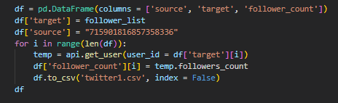
Network Analysis - Dataset
(Top 25 Dell’s followers)
3. Iterate through DellTech’s followers and
retrieve their followers count
4. Save output as a CSV file

Slide 37
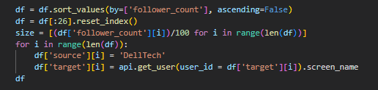
Network Analysis - Dataset
(Top 25 Dell’s followers)
5. Sort the User ID by follower count and
get the top 25 users
6. Iterate through the top 25 users and
calculate their node size according to their follower count

Slide 38
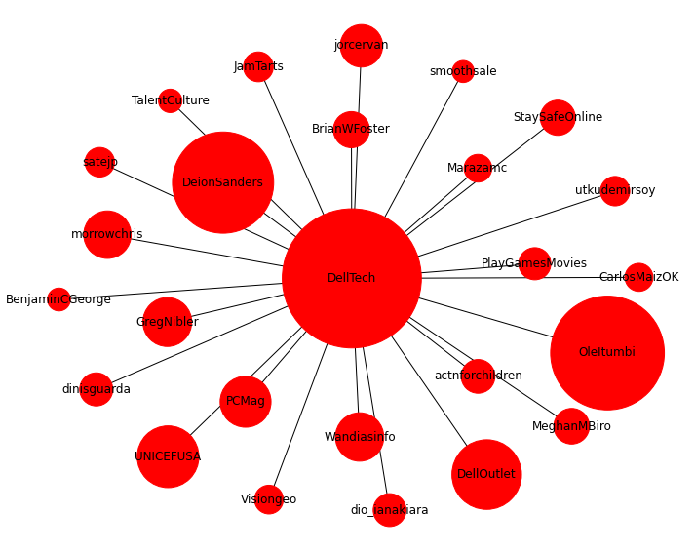
Network Analysis - Reach
Dell Technologies ( @DellTech )
- Top 25 Followers
- Ranked based on their followers
- Key influencers involved in Tech Growth are:
- TalentCulture
- PCMag
- Key Influencers might not be the one retweeting Dell’s posts despite having high followers influencers (Deion Sanders - 88.8k followers)

Slide 39
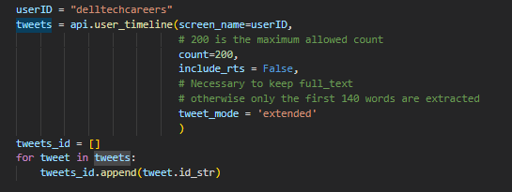
Network Analysis - Dataset
(Highest retweets for recent 200 posts)
Based on DellTechCareers user timeline, we will retrieve its most recent 200 posts ID

Slide 40
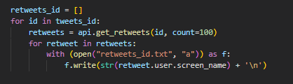
Network Analysis - Dataset
(Highest retweets for recent 200 posts)
2. Iterate through the ID of the 200 posts
and get its retweeters (max 100)
3. Append the screen name of its retweeters

Slide 41
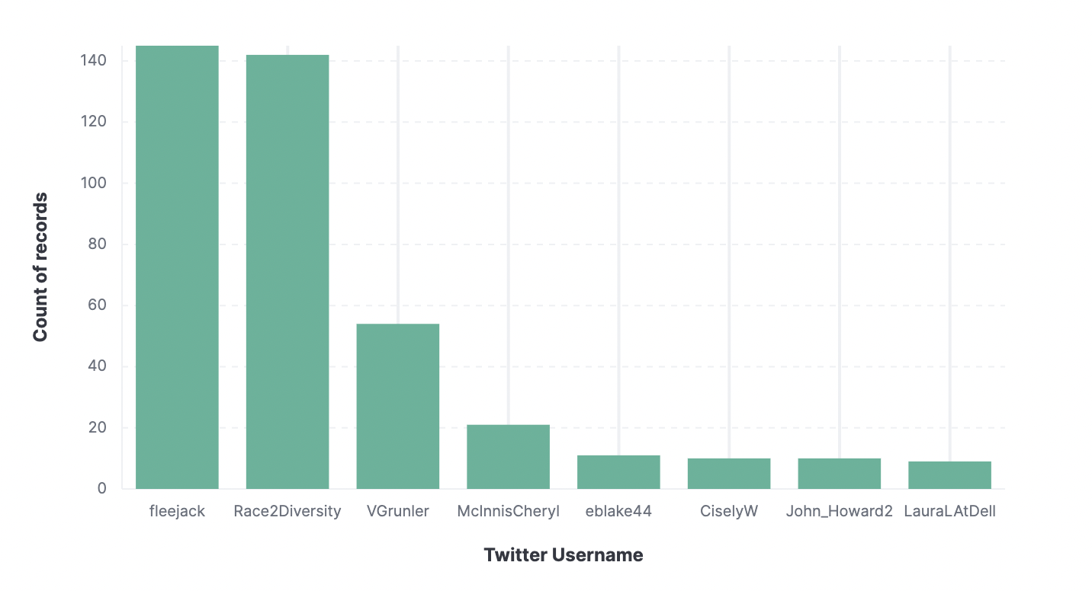
Network Analysis -
Engagement
Passive Followers vs Active Followers
- Focus on Engagement (Interaction)
- Followers that retweets Dell’s tweets
Top 8 engagements which we scraped
(Ranked based on the number of retweets over the last 200 tweets)
Example
- @fleejack (18.7k Followers)
- Although he is not Dell Technologies’ Top 25 followers, nor is he an influencer, the retweets expands Dell Technologies outreach by his number of followers (1st-degree)

Slide 42
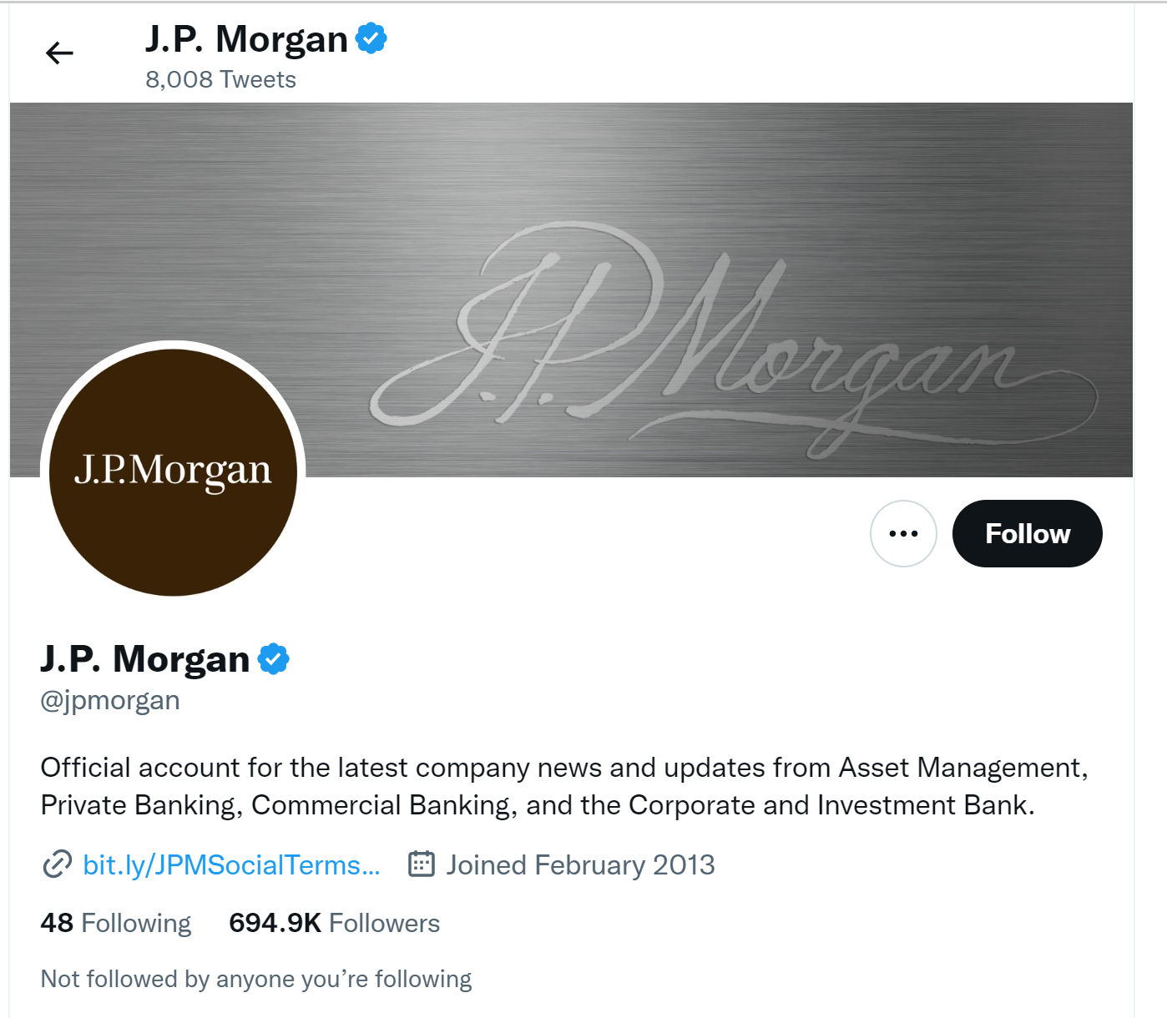
Insights & Findings
J.P Morgan ONLY Twitter’s presence has a whopping 694.9k followers.
The amount of reach and engagement that J.P Morgan has is what Dell should be aiming for.

Slide 43



Insights & Findings
As we dived deeper and find insights about Dell’s Twitter account, the accounts have no distinct content segregation.
For e.g., a hackathon hosted in Singapore can be tweeted under Dell Tech Careers or Dell Singapore.
Audience become less saturated and as a result, its reach decreases.

Slide 44
Additional Information that Dell Requested
Notes:
Dell wants to know the profile of participants participating in the hackathons, hence we decided to use of JP morgan as our source of information

Slide 45

JP Morgan’s Code For Good
JPMorgan Hackathon: Code for Good 2021 - 2022
- Focus on Sustainability
- Real World Problems
- Difficulty: Intermediate
- Prize: iPad & Internship Opportunity
Who Posted on LinkedIn After the Hackathon?
Professionals who posted on LinkedIn:
- Organisers
- Participants who are professionals
Undergraduates who posted on LinkedIn
- Not very few local students
Notes:
We identify the background of users who posted on linkedin after jp morgan hackathon and realized only ¼ posts is linked to undergraduates, whereas the rest is under professionals.
We then filter the title and throw them into undergraduate category if the title contains words like undergraduate else professional.

Slide 46

JP Morgan’s Code For Good
Who Posted on LinkedIn After the Hackathon?
Filtering based on Undergraduate’s Profiles
- Majority of participants does not come from Singapore’s Local Universities
- Limitations:
We fail to consider that JP Morgan’s Code For Good require a tedious interview process to participate in the hackathon, which affects the number of students participating
Notes:
And following on, we breakdown the undergraduates further and realized that most of the universities are not local. These proofs that virtual hackathons does not limit to local participants and hence a wide range of overseas universities actually participantes
In addition we failed to consider that JP morgan requires a tedious interview process, hence affecting the number of students participating.

Slide 47
LIVE DEMONSTRATION
Notes:
Now i will be going through a quick demonstration of kibana. Firstly there are 2 ways to pass the data into kibana, one is through the simple upload of a csv file and the other is ingesting through code. Once uploading of csv file or the ingestion through code, an index pattern will be created.
Next we have different visualisations that could be done in kibana. This includes plotting different kind of graphs such as the standard line plot graphs, bar graphs, pie charts and even word cloud.
Hence these graphs in kibana not only allows us to gain more insights about it, but also allows us to interact with it, giving dell the convenience to filter whenever necessary.
The main difference is that Tableau is a universal analytics tool, while Kibana is embedded into Elastic Search stack. Tableau can connect to pretty much any data, while to use Kibana you need to migrate data into Elastic Search first.
As for handling big data - that depends on how big the ‘big’ is, what hardware specs are available, and so on. Kibana (with Elastic Search), is very good at handling large volumes of data, but so is Tableau if connected to Redshift or EXASOL or Spark or similar, or if Tableau is used on a hardware/VM with generous specs and uses its own embedded data engine. Hence, using this opportunity to learn this new technology stack does no limit our learning to just this course, but future considerations as well! And Thank you Professor Gao who gave us the freedom to use whatever, and whichever we want :]

Slide 48
RECOMMENDATION

Slide 49


Strategise Social Media Messages
In Summary….
Dell Singapore is not capitalising on their Social Media Engagement messaging, by being a passive account. (No Tweets & Following)
With 2.85m Twitter users in Singapore, in 2022, Dell Singapore should capitalise on this growing trend of social media to expand their engagement with participants
Dell can use keywords which has very positive sentiments to capture the attention of the potential participants.
Notes:
Based on network analysis

Slide 50


Tap on Twitter to increase outreach
Extending Engagement with Participants
Dell Technologies should not have multiple accounts
Notes:
Like what andy has mentioned earlier. Dell should only have one main account similarly like JP morgan, and not multiple accounts are they bring confusion to users. As it will be difficult to maintain, evidently, Dell Singapore has 0 tweets and it is clearly inactive.
Can take a look at JPMorgan.

Slide 51


Increase Motivation for Participants
In Summary….
Is material goods (Tangible Rewards e.g. Cash Prizes) still remains as top priority..?
Trend:
1) The larger the tangible rewards, the higher the number of participants.
2) The easier the hackathon, the higher the number of participants
These 2 are interrelated, as the easier the hackathon, the easier it is to obtain the rewards.
Participants are humans after all….
Notes:
Based on sent analysis

Slide 52
Common Trends of Hackathons
(Topics / Themes)
In Summary….
Reddit Emphasizes on Topics regarding to AI & BlockChain
Virtual Hackathons are more commonly hosted as compared to physical hackathons
But virtual hackathons are not limited to Singapore as it is difficult to restrict non-Singaporeans from registering
With Cloud being an enabler, Dell can focus on the topics that are surging in trends such as Supply Chain Management, Game Development and Sustainability
Notes:
Based on topic modeling

Slide 53
Conclusion
Learning Outcomes
Limitations from Kibana visualisations as not everything can be done using the Kibana platform
We did not deploy the dashboard on EC2 or any equivalent platform, hence, collaboration is not as seamless as it seems.
Customer Centric Approach where we are constantly gaining feedbacks from our sponsors, asking them what they need, and how else we can help them
A vast variety of web-scraping tools and libraries and workarounds whenever the website blocks the normal tool

Slide 54
Thank you very much for listening to our presentation
_________________________________________
Questions & Answers
Prepared for: Dr Wei Gao

